Slide 1


Slide 2

A pointer is a memory variable that stores a memory address.
Pointer can have any name that is legal for other variable and it is declared in the same way like other variables but it is always denoted by ‘*’ operator.
Data is manipulated with address.
Pointer of any data type requires 4-bytes in memory.

Slide 3

Pointers save memory space.
Execution time with pointer is faster.
Dynamically memory is allocated.
They are useful for representing two-dimensional and multi-dimensional arrays.

Slide 4

Syntax:
datatype *variable_name;
Ex:
int *p;
->p is an integer pointer and it tells to the compiler that it holds the address of any integer variable.
Indirection operator or dereference operator

Slide 5

* is used in two ways with pointers:
Declaration:
When a pointer is declared , the * indicates that it is a pointer variable and not normal variable.
Dereference:
When a pointer is dereferenced , the * indicates that value at that memory location stored in the pointer is to be accessed rather than memory itself.

Slide 6

Ex:
Int a=10,*p;
P=&a;
Printf(“%d”,p);
Printf(“%d”,*p);
Printf(%d”,a);
10
*p=*(&a)
Value of a
a
value
address
*p
4060
p
Value
4064
Address

Slide 7

Call by reference in functions is implemented using pointers.

Slide 8

Addresses of a,b
Are passed
Main()
{
Int a=10,b=20;
swap(&a,&b);
Printf(“%d %d”,a,b);
}
Void swap(int *x,int *y)
{
Int temp;
Temp=*x;
*x=*y;
*y=temp;
Printf(“%d %d”,*x,*y);
}
Values at that address are taken
X=20,y=10
A=20,b=10

Slide 9
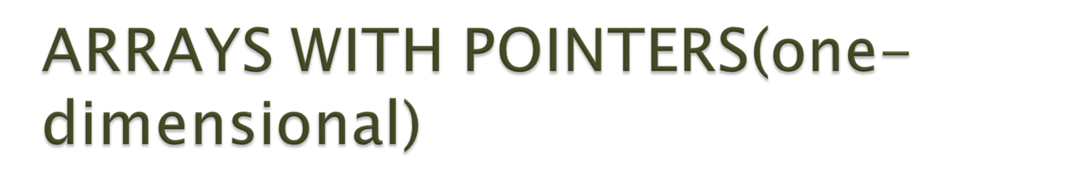
Array name by itself is an address or pointer constant to the first element in the array.
This element is a[0] or *a
A[0] | 2
A[1] | 3
A[2] | 4
A[3] | 5
a

Slide 10
To access an array , any pointer to the first element can be used instead of the name of the array.
Given pointer p , p(+/-)n is a pointer to the value n elements away.
*(a+n) and a[n] are identical.
Addresses
(P+n)
Values
*(p+n)
A[0] | 2 | *p | 4056
A[1] | 3 | *(P+1) | 4060
A[2] | 4 | *(p+2) | 4064
A[3] | 5 | *(p+3) | 4068

Slide 11

P=&a[0][0]
Addresses
(p+n)
A[0][0] | 1 | *p | 4050
A[0][1] | 2 | *(p+1) | 4054
A[0][2] | 3 | *(p+2) | 4058
A[1][0] | 4 | *(p+3) | 4062
A[1][1] | 5 | *(p+4) | 4066
A[1][2] | 6 | *(p+5) | 4070
A[2][0] | 7 | *(p+6) | 4074
A[2][1] | 8 | *(p+7) | 4078
A[2][2] | 9 | *(p+8) | 4080
Values *(p+n)

Slide 12

Use pointers that point to other pointers.
Ex:
Int a,*p,**q;
A=10;
P=&a;
Q=&p;
printf(“%d”,a);
printf(“%d”,*p);
printf(“%d”,**q);
a
10
*p=*(&a)(value at a)
*p
4060
**q=**(&p)=**(&(&a))
p
Address of a
4060
**q
4062
q
Address of p
4062
4066

